Slide 1

KESHAVJI BHARMAL SUMARIA COMMERCE & NATARAJ PROFESSIONAL SCIENCES COLLEGE, VAPI
A
Project Report on
LIBRARY MANAGEMENT SYSTEM
Submitted BY
SHUBHAM MOHAPATRA / 1335
Under the guidance of
PRITESH SIR

Slide 2
embee

Slide 3
INTRODUCTION
embee is a blogging platform that allows users to create, manage, and share their content seamlessly. It enables users to register, log in, and maintain their own profile. Users can create posts, save drafts, edit or delete them, and publish drafts when ready. It supports adding, editing, and deleting comments on posts, as well as marking and unmarking posts as favourites for quick access later. The system provides a smooth and responsive interface for easy navigation and ensures a complete CRUD experience for posts, drafts, and comments.

Slide 4
PROJECT USERS AND FUNCTIONALITIES
User
Register and log in using email and password
Create, edit, and delete drafts
Publish drafts into posts
Create, edit and delete posts
Mark and unmark posts as favourites
Add, edit and delete comments on posts
View all posts and posts details
View own drafts, posts and favourites
Log out securely

Slide 5
PROJECT PROFILE
Project Title | embee
Project Type | Web Application
Font End Technologies | React
Back End Technologies | PHP, MySQL
Duration | 3 Months
Internal Guide | Pritesh Sir
Submitted By | Shubham Mohapatra

Slide 6
DATA FLOW DIAGRAM

Slide 7
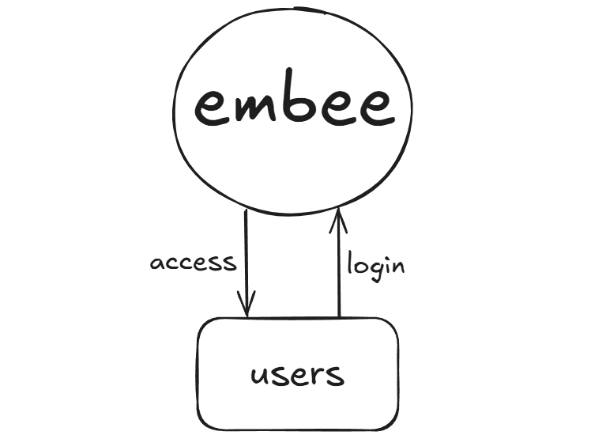
0-LEVEL DFD

Slide 8
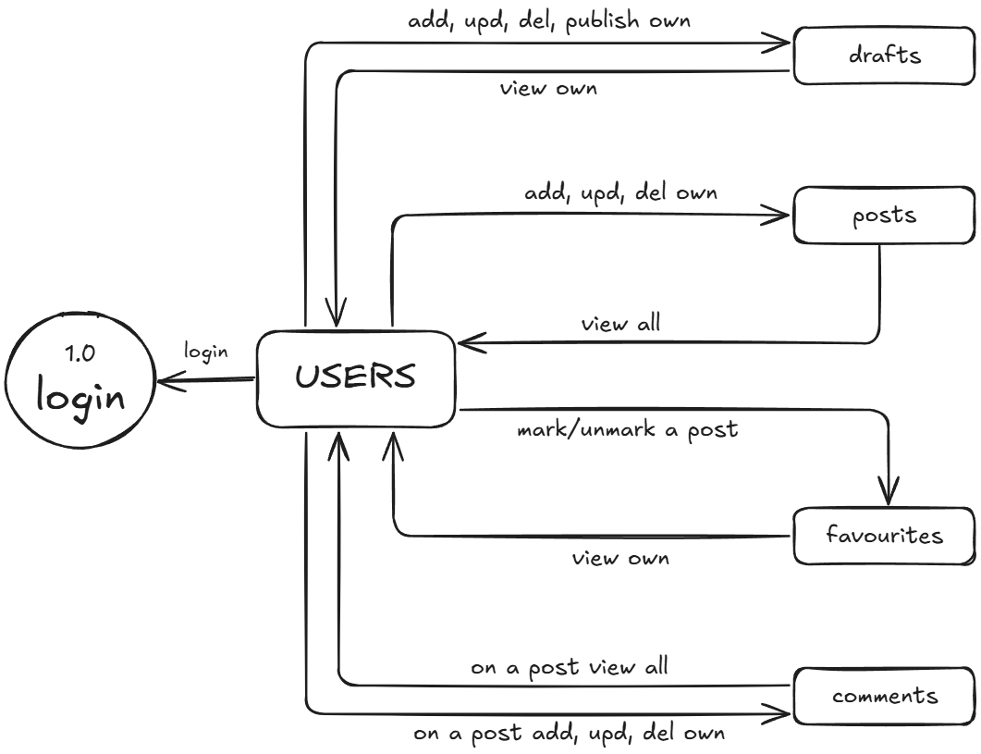
1-LEVEL DFD

Slide 9
ER DIAGRAM

Slide 10
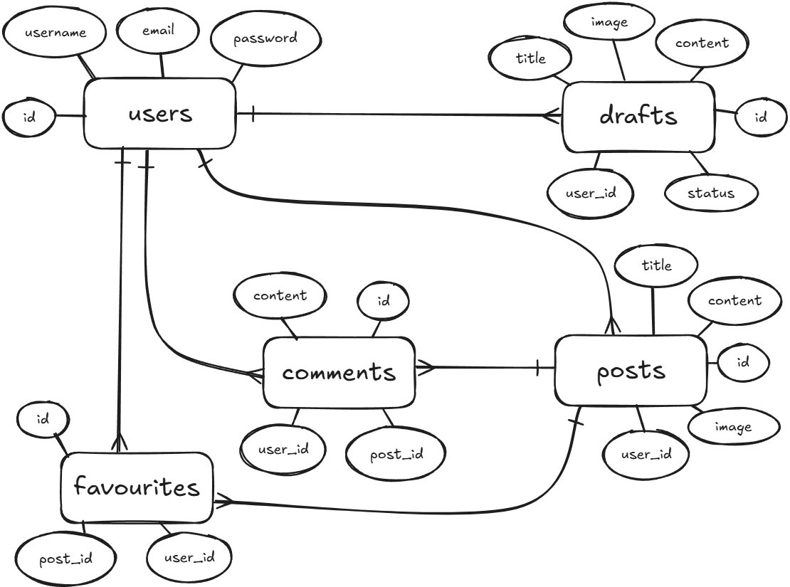

Slide 11
DATABASE DESIGN

Slide 12
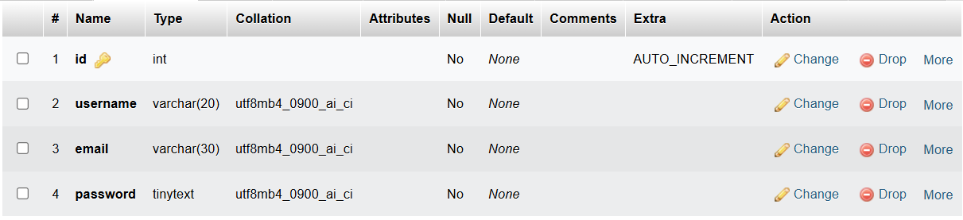
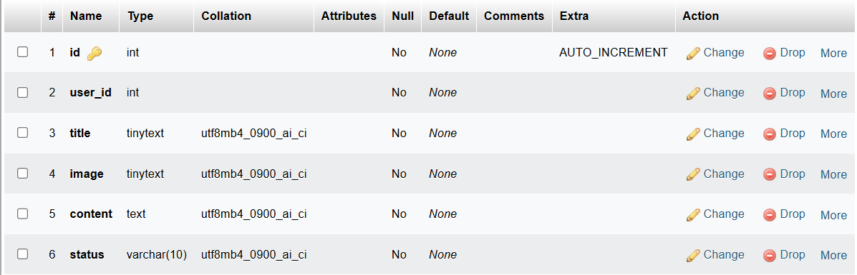
Users Table
Drafts Table

Slide 13
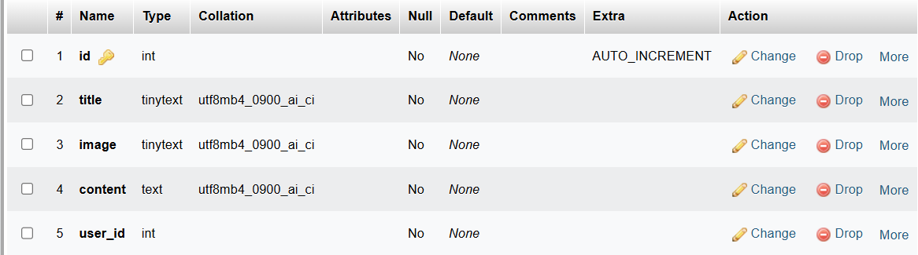
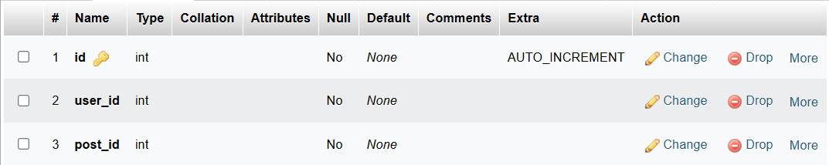
Posts Table
Favourites Table

Slide 14
Comments Table

Slide 15
IMPLEMENTATION DETAILS

Slide 16
User Portal

Slide 17
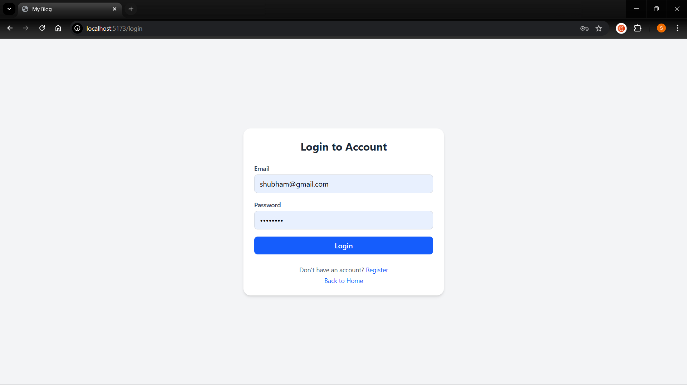
Login Page

Slide 18
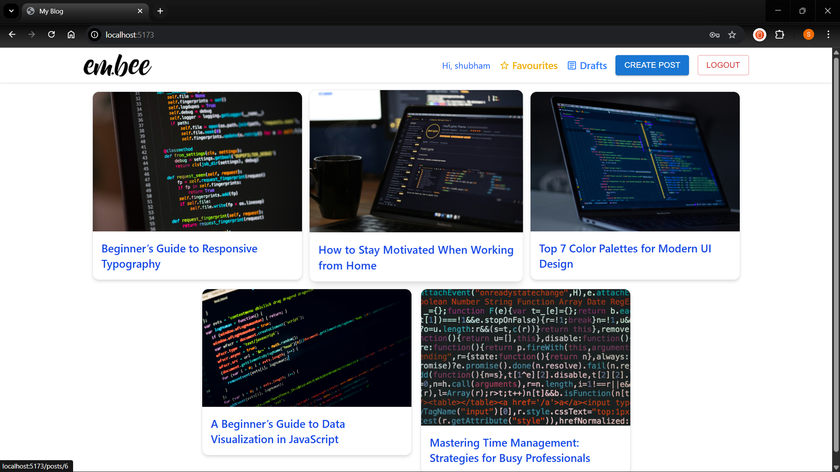
Home Page

Slide 19
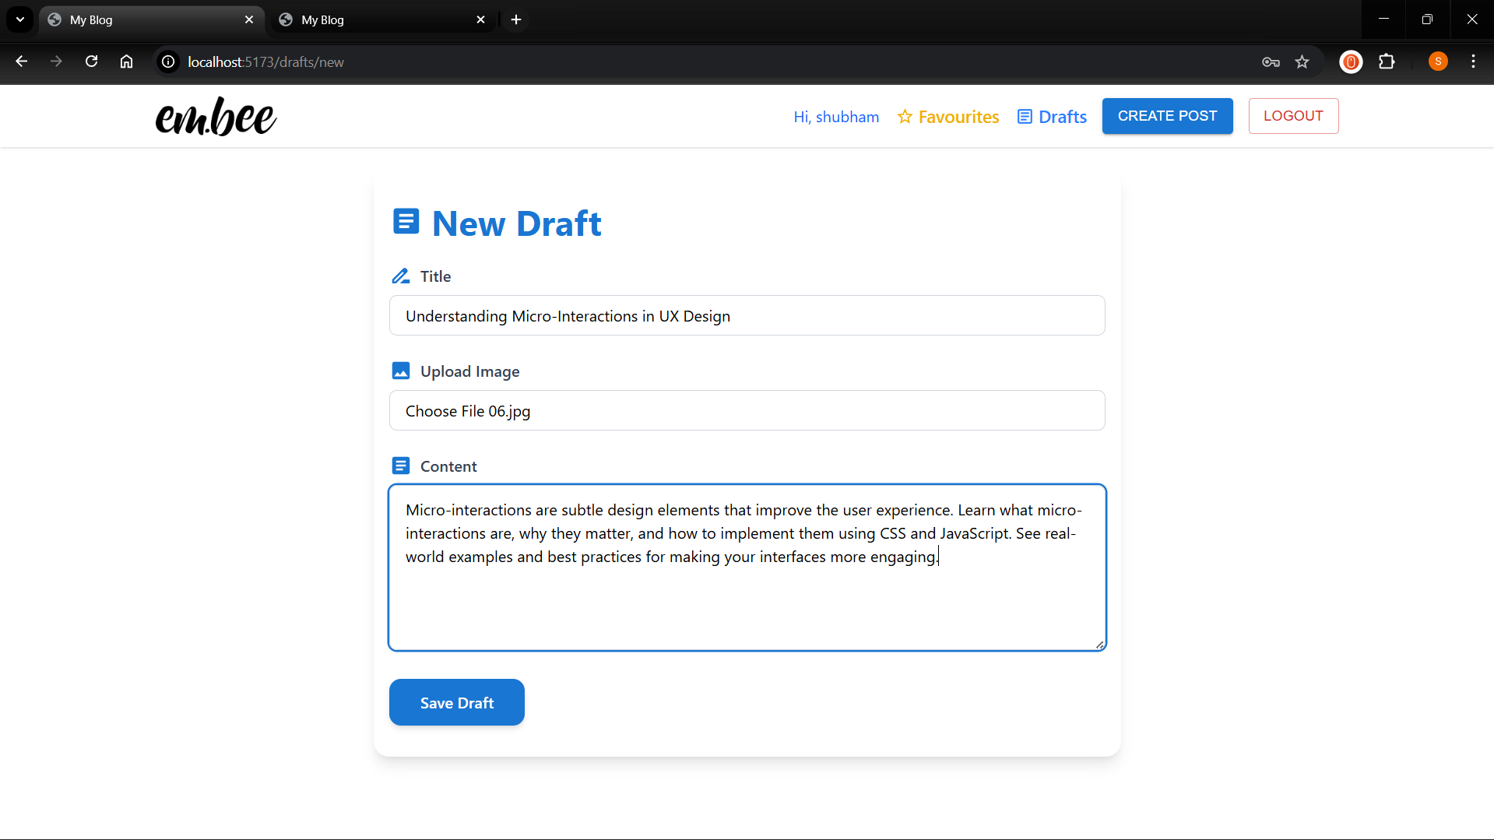
Create Draft Page

Slide 20
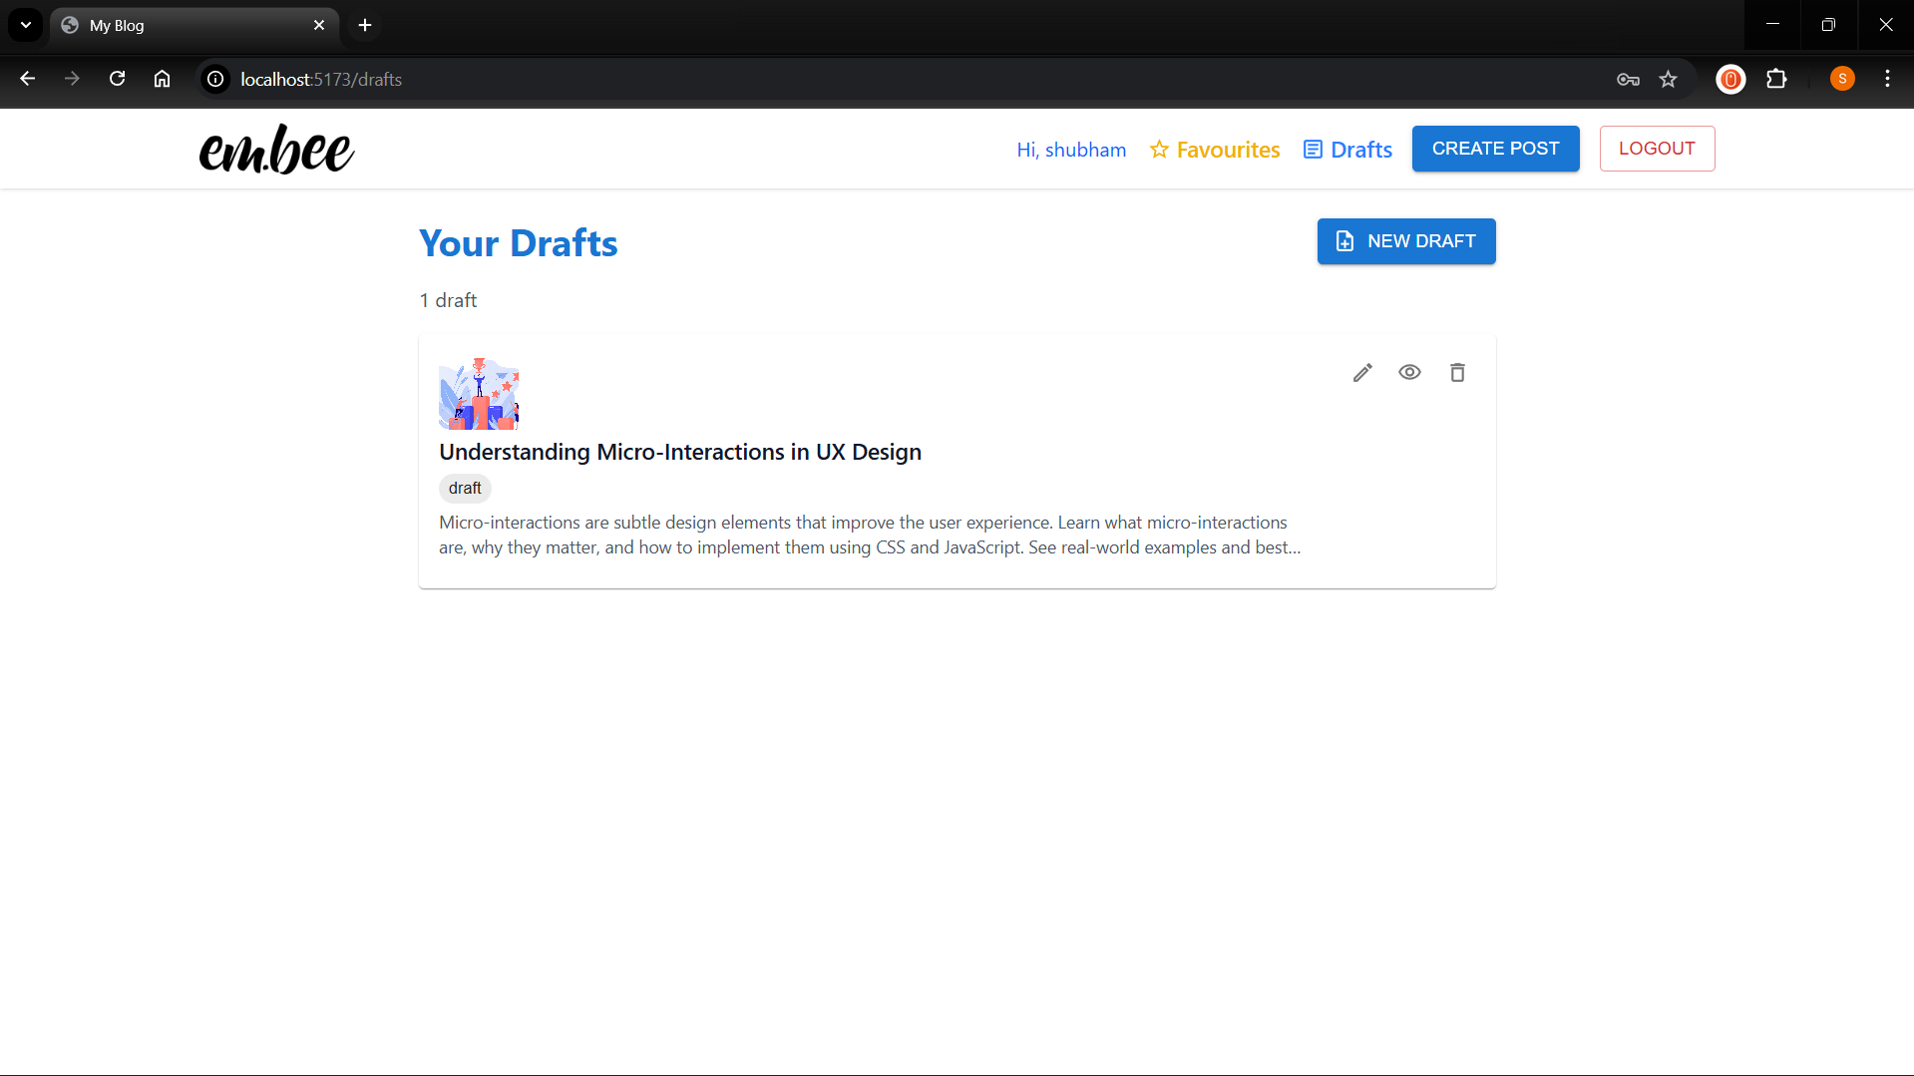
All Drafts

Slide 21
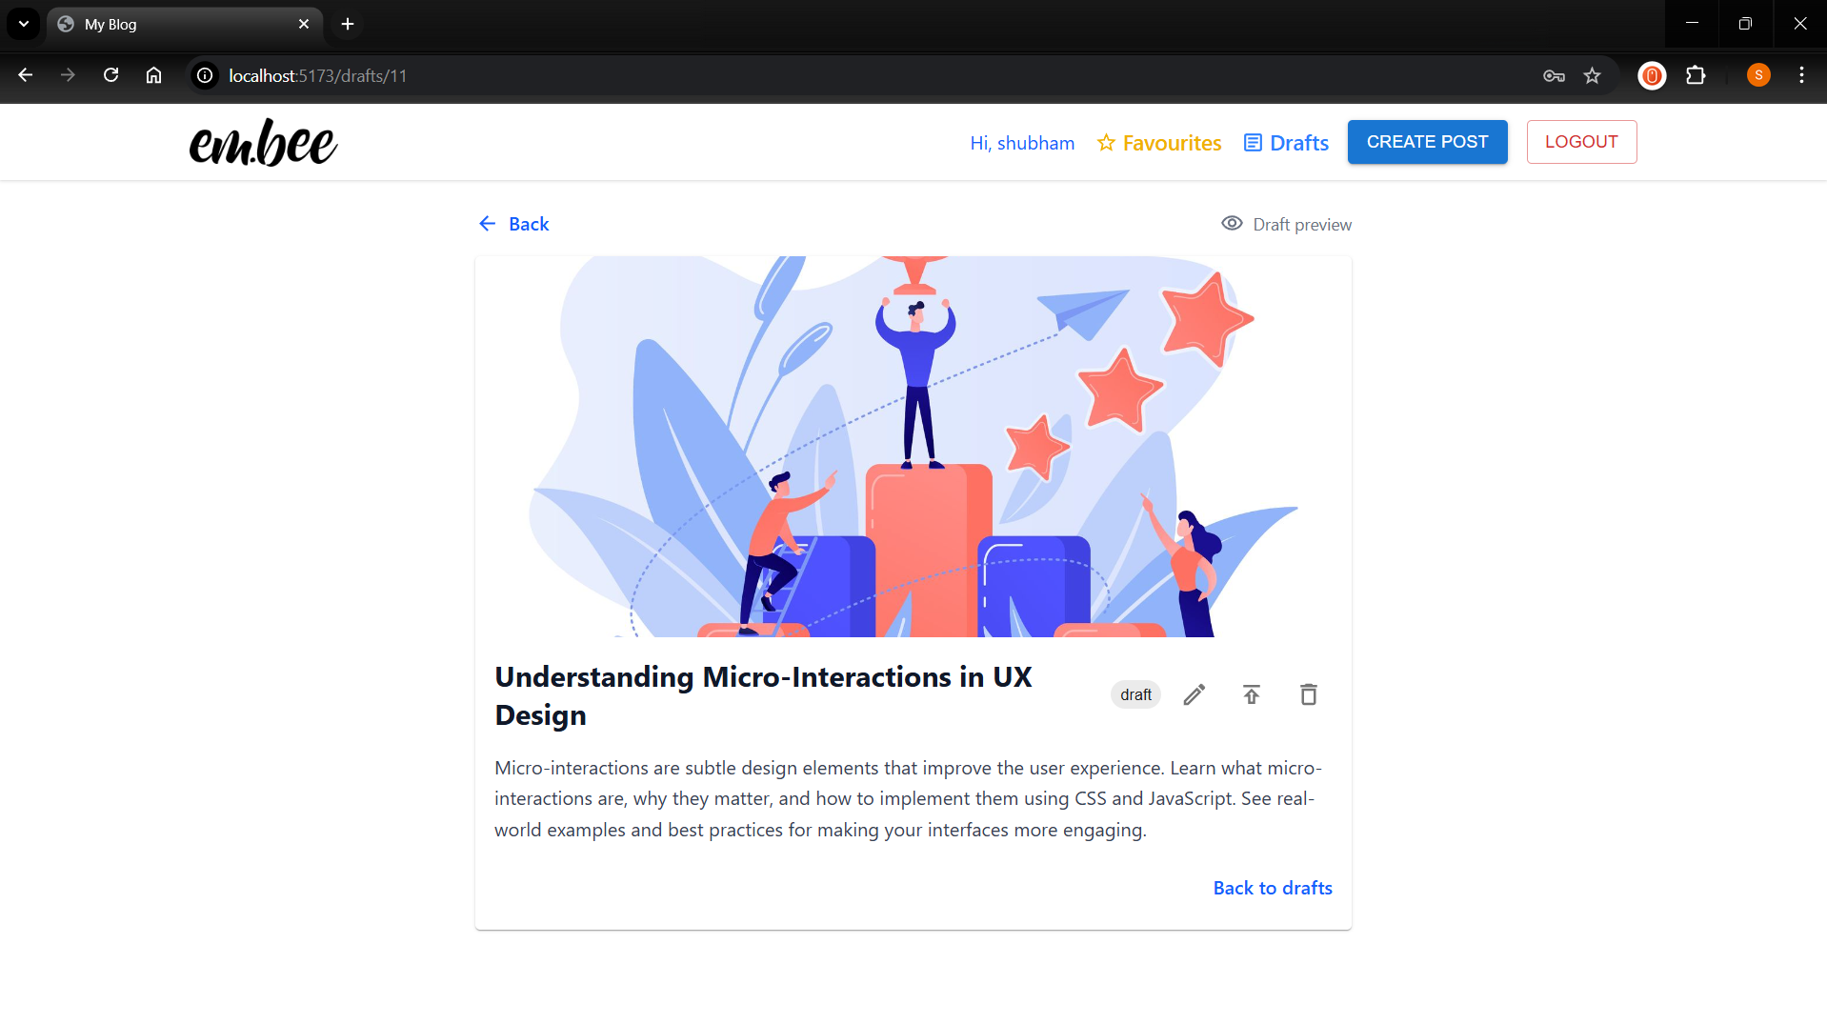
Draft Details Page

Slide 22
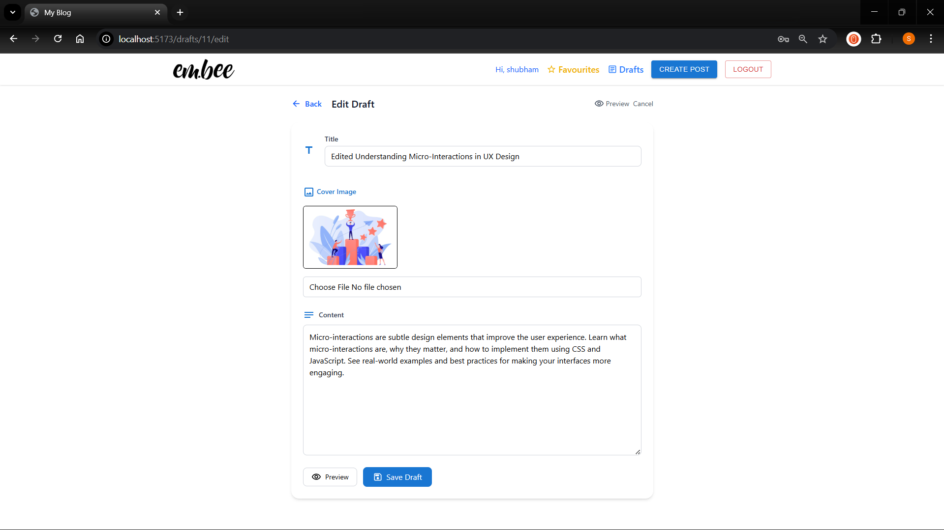
Edit Draft Page

Slide 23
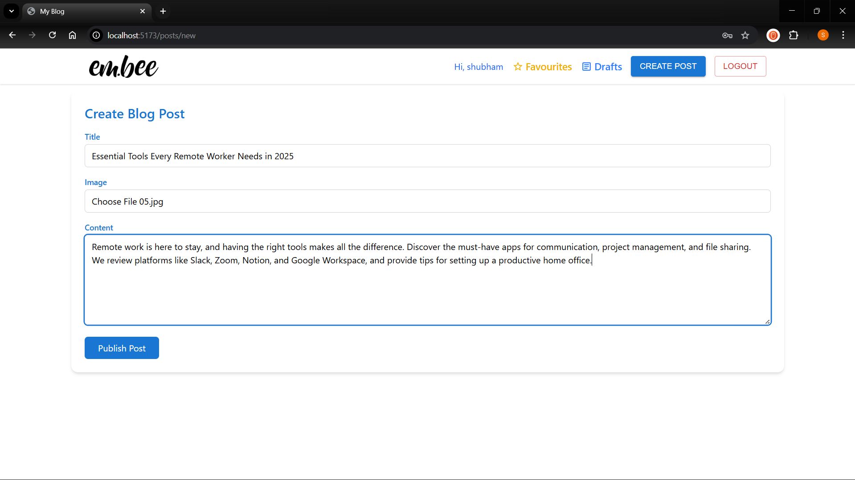
Create Post Page

Slide 24
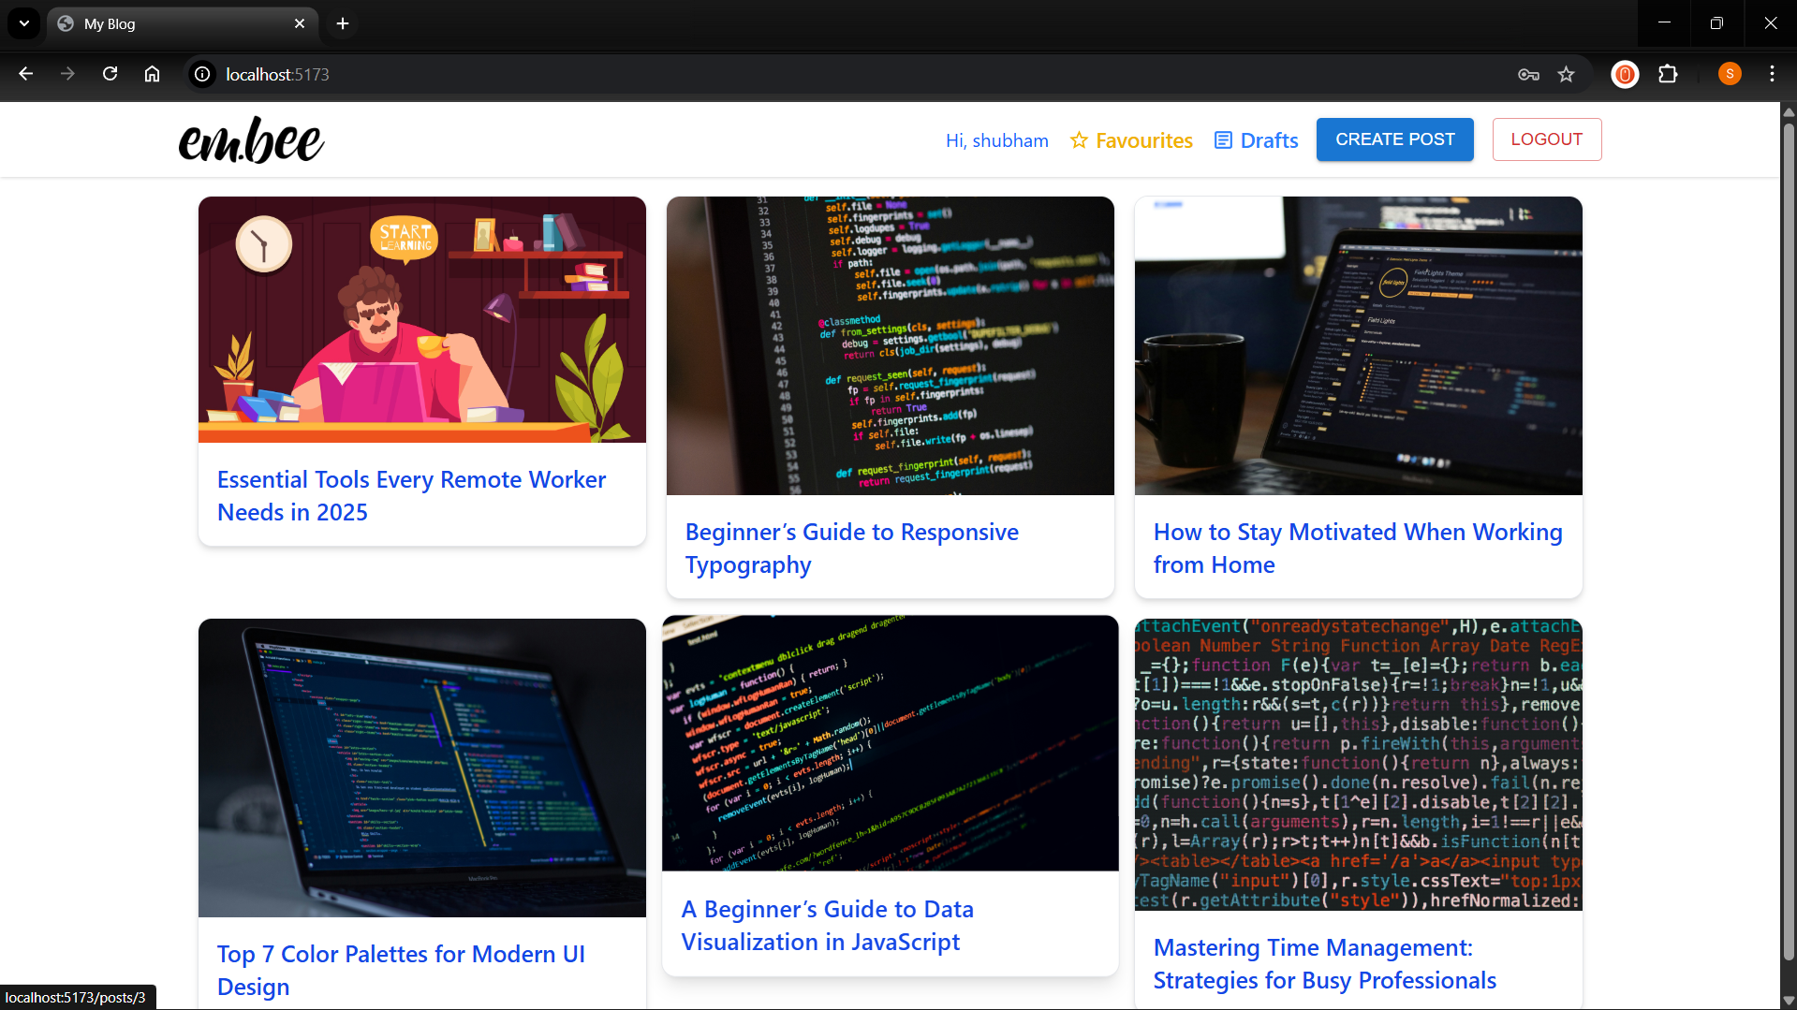
All Posts Page

Slide 25
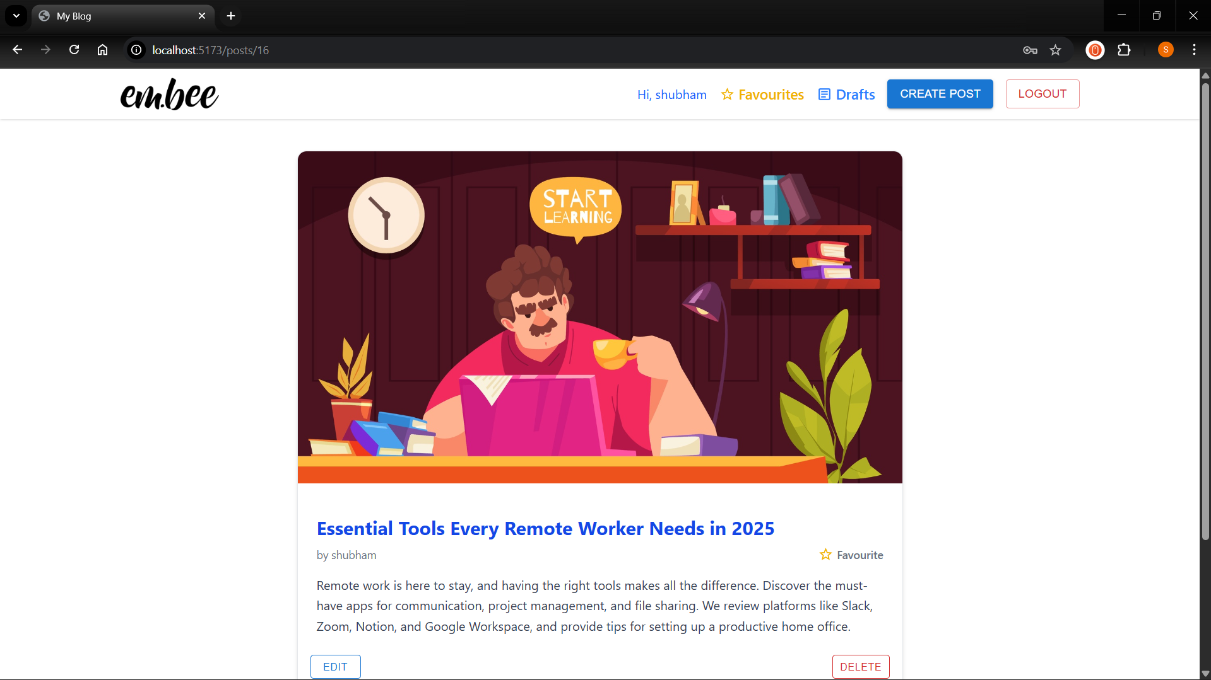
Post Details Page

Slide 26
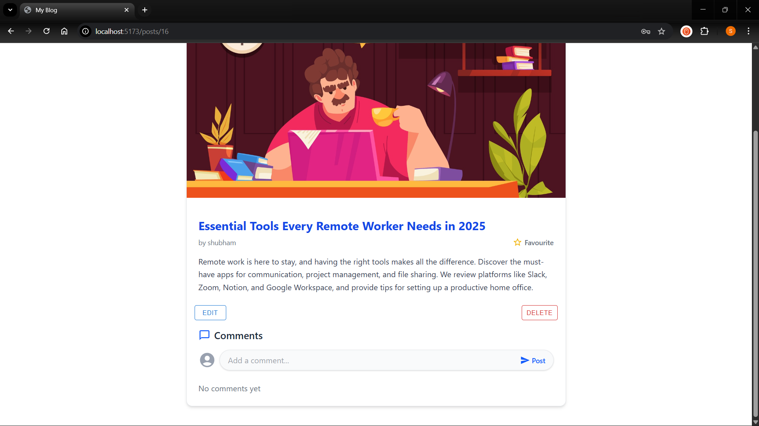

Slide 27
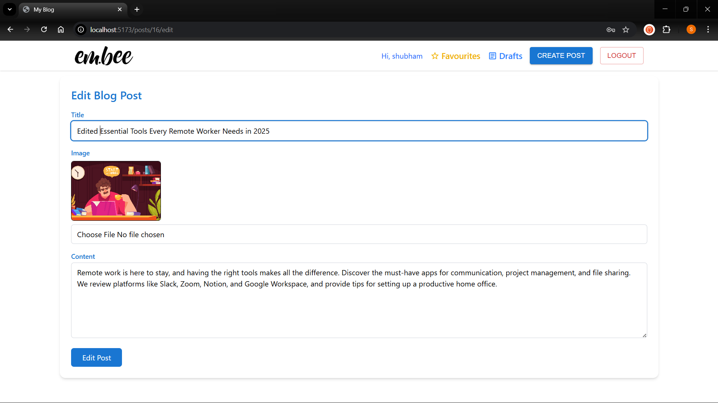
Edit Post Page

Slide 28
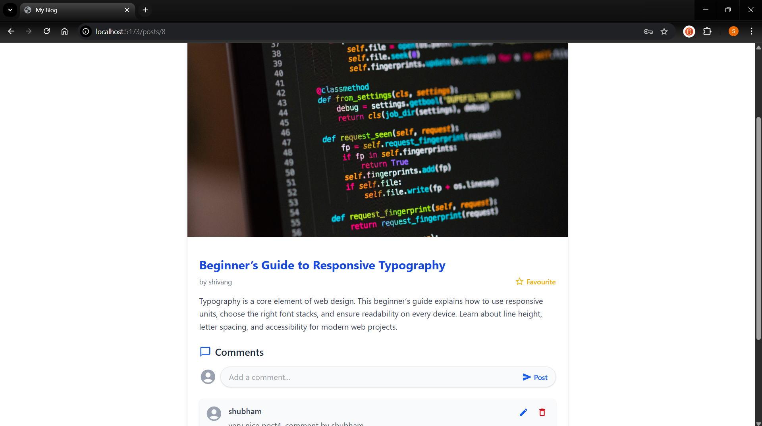
Mark/Unmark a Post as Favourite

Slide 29
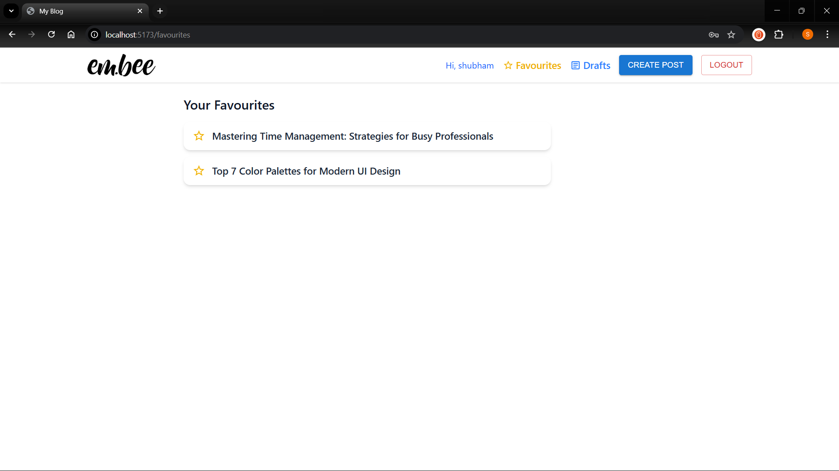
Favourites Page

Slide 30
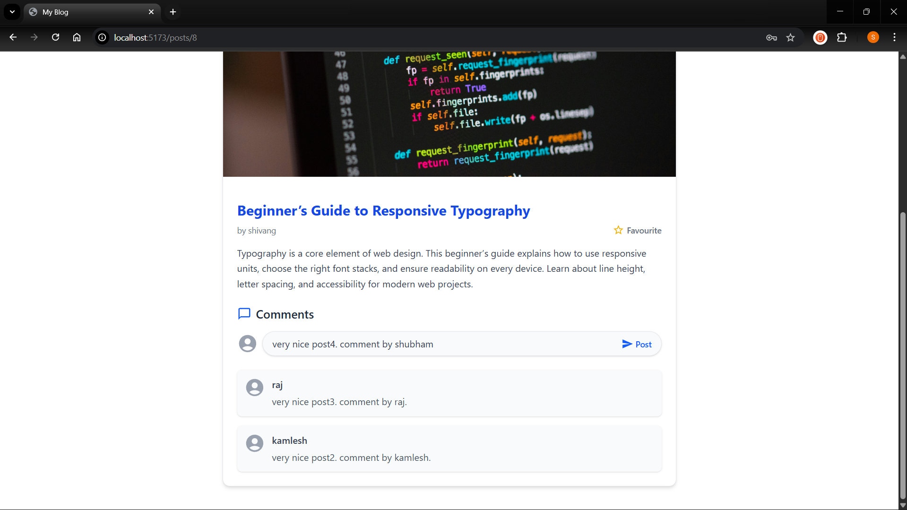
New Comment

Slide 31
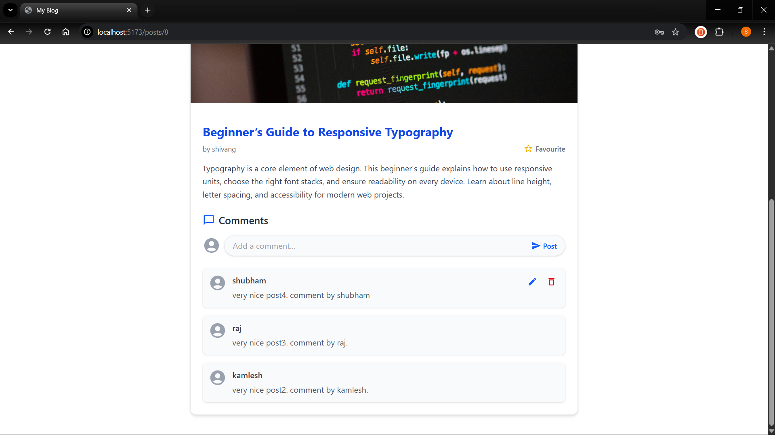
All Comments on a Post

Slide 32
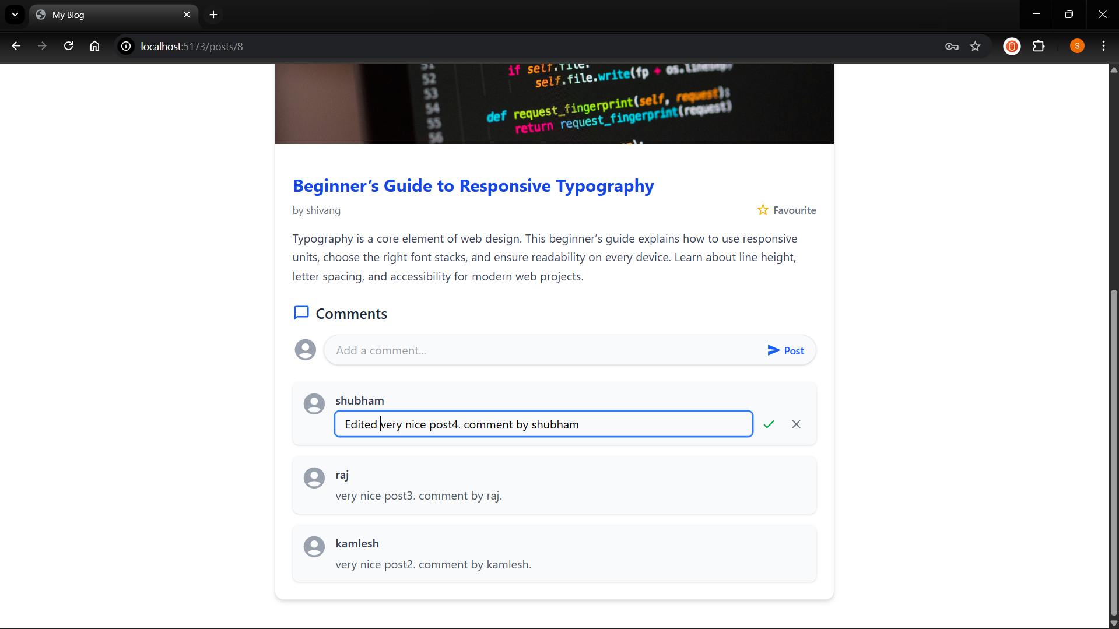
Edit Comment

Slide 33
BIBLIOGRAPHY
Search Engine : Google
Online Resources:
https://react.dev/
https://tailwind.com/docs
https://www.w3schools.com/
https://www.php.net/docs.php
https://developer.mozilla.org/

